Slide 1
Operationalise your Kubernetes cluster with Azure
Bruno Faria

Slide 2



Bruno Faria
MVP Reconnect @ 2018
Principal Consultant C&I @ Insight
Azure Advocate
Azure Compute IaaS and PaaS
Automation
DevOps
brunofaria
bnlf
nunes@outlook.com

Slide 3
Agenda
Overview
What is Kubernetes
Components
Objects
Configuration
AKS Cluster Architecture
AKS Nodes and Pods
Demo

Slide 4
Kubernetes Overview

Slide 5
What is Kubernetes?
Why do I need it?
What I can do with it?
Why Containers?
What does Kubernetes mean?

Slide 6
Kubernetes Components
Master
Kube-apiserver
Etcd
Kube-scheduler
Kube-controller-manager
Cloud-controller-manager
Node
Kubelet
Kube-proxy
Container runtime

Slide 7
Kubernetes Objects
Persistent entities in the Kubernetes system. Kubernetes uses these entities to represent the state of your cluster such as:
What containerized applications are running (and on which nodes)
The resources available to those applications
The policies around how those applications behave, such as restart policies, upgrades, and fault-tolerance

Slide 8
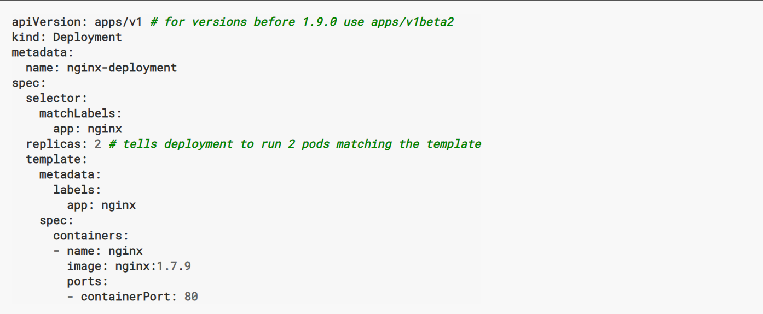
Kubernetes Objects
When you create an object in Kubernetes, you must provide the object spec that describes its desired state:
More info: https://kubernetes.io/docs/concepts/overview/working-with-objects/kubernetes-objects/

Slide 9
Kubernetes Configuration
All-in-One Single-Node Installation
Single-Node etcd, Single-Master, and Multi-Worker Installation
Single-Node etcd, Multi-Master, and Multi-Worker Installation
Multi-Node etcd, Multi-Master, and Multi-Worker Installation

Slide 10
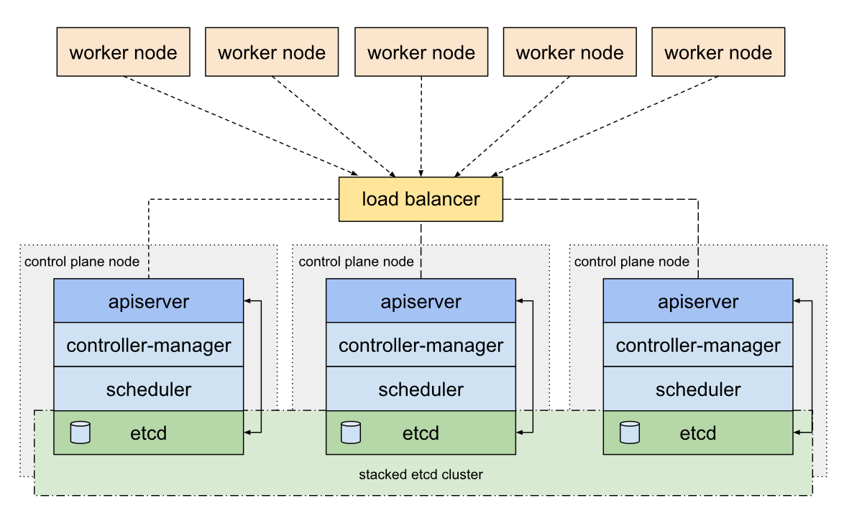
Kube HA - stacked etcd

Slide 11
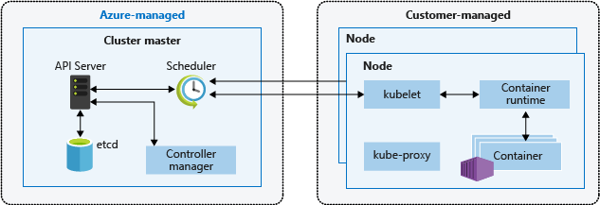
AKS Cluster Architecture
Single-tenant cluster master, with dedicated servers (API, Scheduler, etcd, Controller Mgr, etc.)
You define the number and size of the nodes, and the Azure platform configures the secure communication between the cluster master and nodes

Slide 12
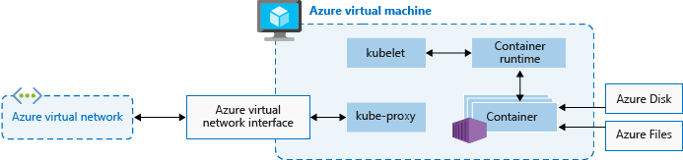
AKS Nodes and Node Pools
Processes orchestration requests
(Docker!) Allows containerized applications to run and interact with additional resources such as the virtual network and storage
Routes network traffic and manages IP addressing for services and pods

Slide 13
DEMO

Slide 14
AKS Cluster Upgrade
The Kubernetes scheduler prevents additional pods being scheduled on a node that is to be upgraded.
Running pods on the node are scheduled on other nodes in the cluster.
A node is created that runs the latest Kubernetes components.
When the new node is ready and joined to the cluster, the Kubernetes scheduler begins to run pods on it.
The old node is deleted, and the next node in the cluster begins the cordon and drain process.

Slide 15
Thank You

